Slide 1
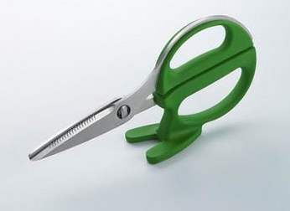
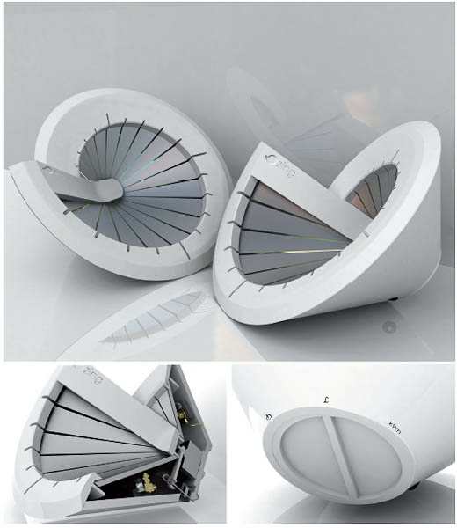
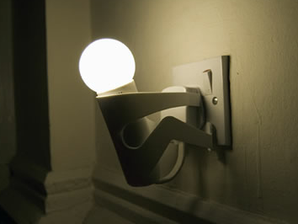

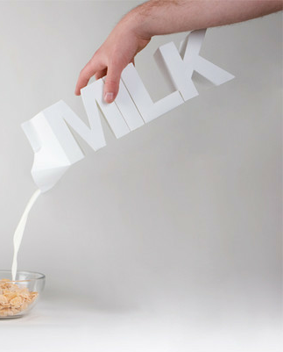
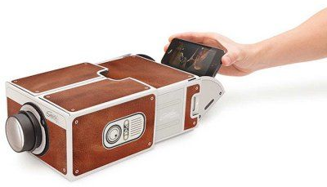
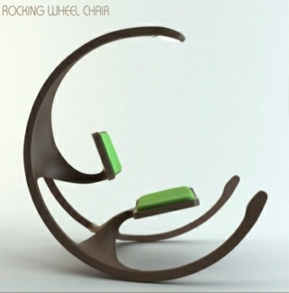
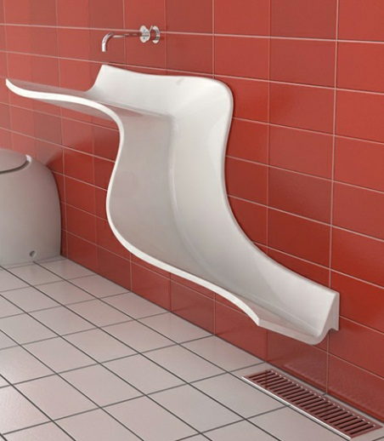
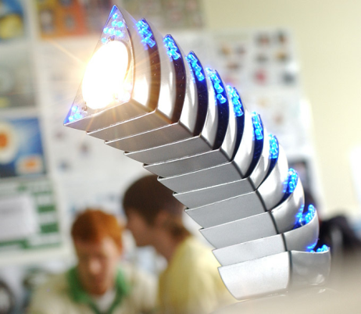
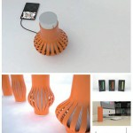
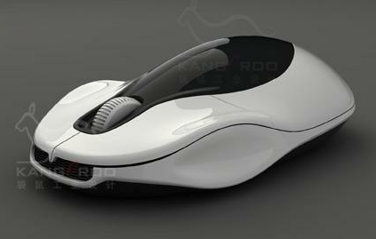
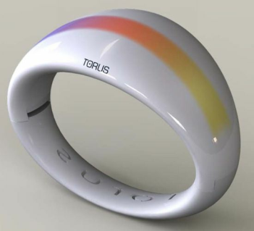
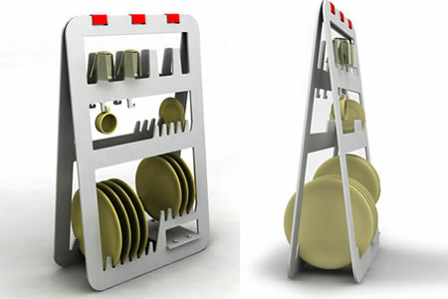
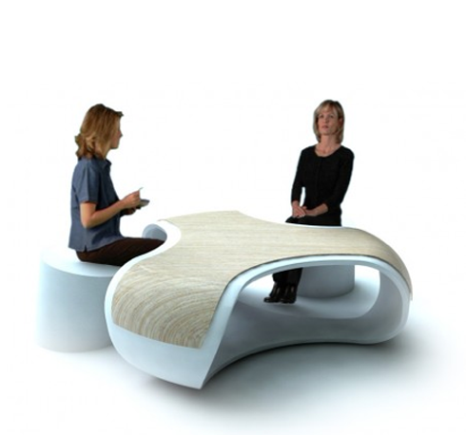
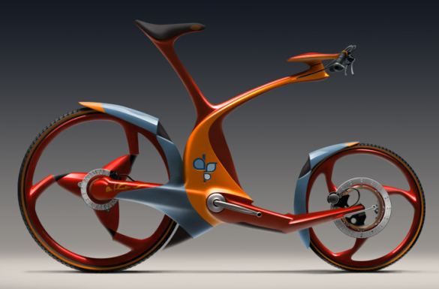
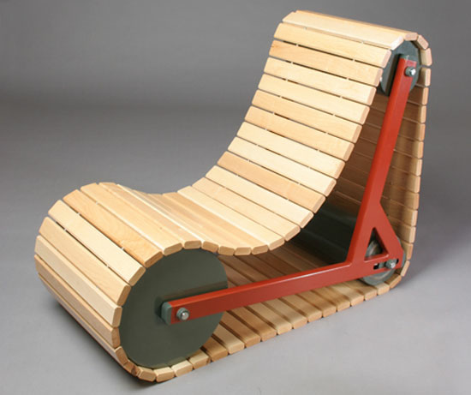
DESIGN
iGCSE Design Technology Introduction
Notes:
Demonstration of pewter casting
- Features of moulds & potential issues
- Demonstration of hand made mould to
pewter casting
- Student create practice mould using hand
tools and cast.

Slide 2
Helping Hand - Design
Learning Objectives
Discuss plastic uses and categories / sustainability issues
Evaluate and select final design
Using masks to create surface details
Measure, mask and mark to prepare for manufacture
DESIGN

Slide 3
Helping Hand - Design
Cover Lesson 1 Tasks
Discuss / Think-Pair-Share: Why do we use plastics?
Read: Thermo vs Thermo-setting plastics / Recycling. Which recycling code is acrylic? Is it sustainable? Write your answer on the back on the design sheet
Read the Wind Spinner Design Brief and remind yourself of the goal
Finish drawing your 3 design ideas for the wind spinner
Peer-evaluate the strength of your design ideas and select your final design. Choose your best design based on the data collected
Manufacture Prep:
Write the manufacturing steps next to your evaluations
Using masking tape and sheet vinyl, transfer your surface detail design to the acrylic template
Use a whiteboard marker (non-permanent) to mark the wastage / overall shape on the acrylic template
Mark where to drill the hole for the spinner
5. Tidy up,all templates & Design Sheets / Evaluation in Student folders
Look at the spinner examples in the 10GCSE Cupboard for guidance
DESIGN

Slide 4

Sustainables - Design
Character Skills
Plastics
Think-Pair-Share
DESIGN
Why do we use plastics?
Why is plastic generally unsustainable?
How can we use plastics more sustainably?

Slide 5
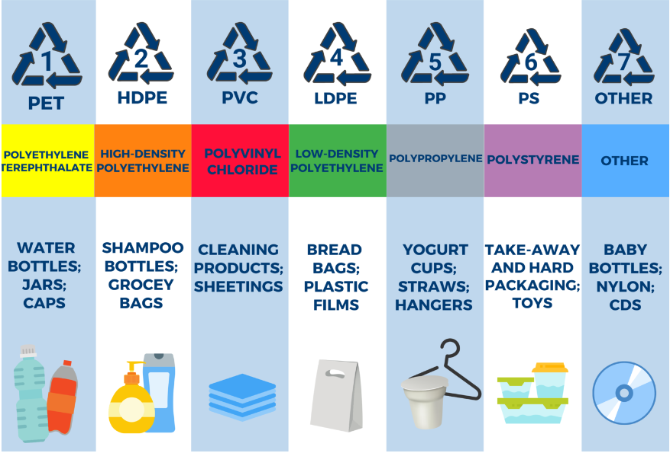
Sustainables - Design
Recycling Plastic
Name the plastic and what its used for…
DESIGN
A Thermoplastic can be melted and reformed.
A Thermoset Plastic, once formed, cannot be recycled or reshaped.
Symbols are found on most thermoplastics to help identify and separate for recycling.

Slide 6
IGCSE Design Technology
Wind Catchers
Design Brief:
Design and make an ornament that uses
wind power to create movement.
DESIGN
Criteria:
It must be made out of acrylic.
It must have 1 form of heat process in its manufacture.
It must have surface detail that follows a theme
It must have at least one shape modification
It must not have any sharp corners
It must have a high quality finish.

Slide 7
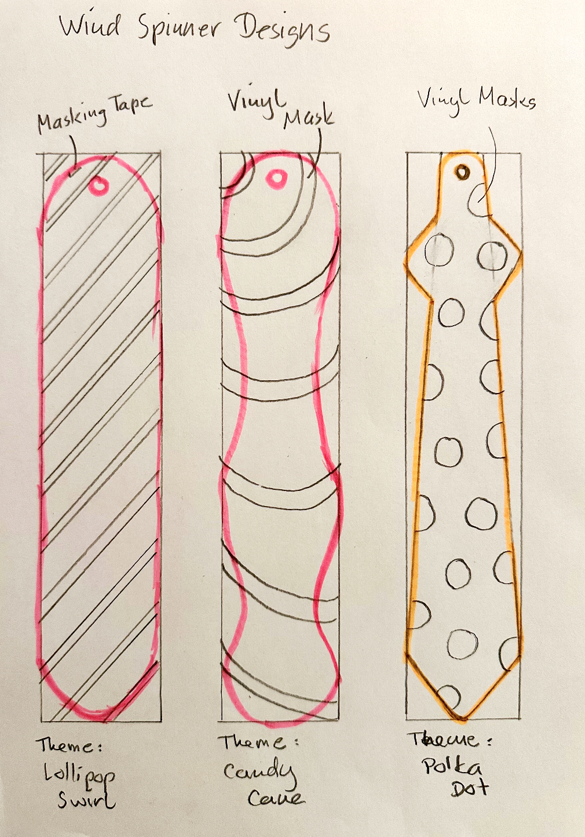
IGCSE Design Technology
Wind Catchers
Design Brief:
Design and make an ornament that uses
wind power to create movement.
Use Colours and annotations to communicate the features of your design
Peer evaluate your ideas and choose your favourite and strongest idea
DESIGN

Slide 8
IGCSE Design Technology
Wind Catchers
Evaluate Design Ideas:
Rate all designs at your table using the table, including your own. Record the evaluation on the back of your design sheet
It must have surface detail that follows a theme
It must have at least one shape modification
It must not have any sharp corners
It must have a high quality finish.
On a scale of 1-5, rate the criteria below to identify the best design
DESIGN
Criteria / Design | TOTAL | Material | Process | Surface Details | Form | Safety | Ease of Manufacture | opinion overall score (creativity,original)
Design 1 | 19 | Acrylic (PMMA) Recycling Code 7 | Thermo- forming, masking, sand- blasting | 3 | 3 | 5 | 5 | 3
Design 2 | 19 |  |  | 3 | 4 | 5 | 4 | 3
Design 3 | 21 |  |  | 3 | 5 | 4 | 4 | 5
Tip: Take the average rating of each score you get, i.e. Form: 2/3/2/4 = 2.75 → 3

Slide 9
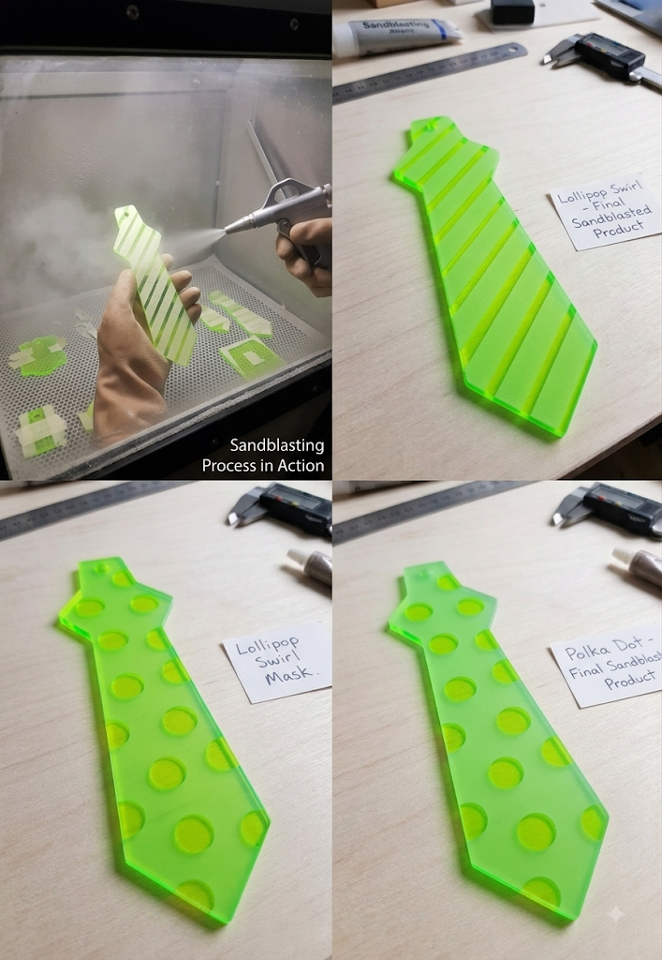
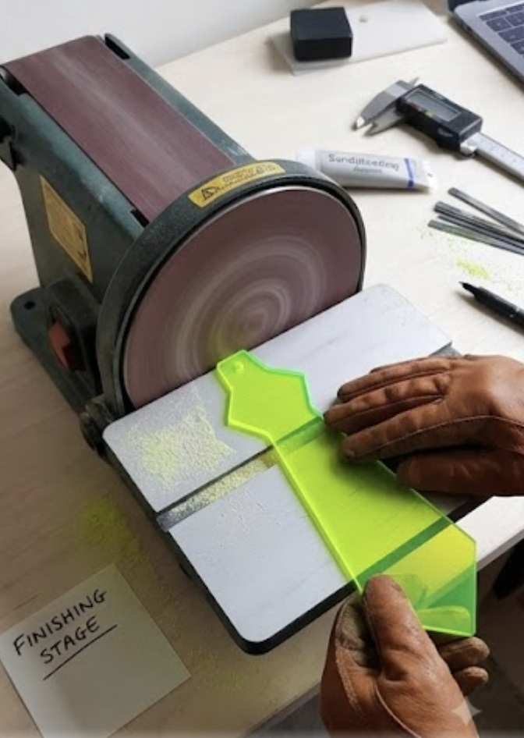
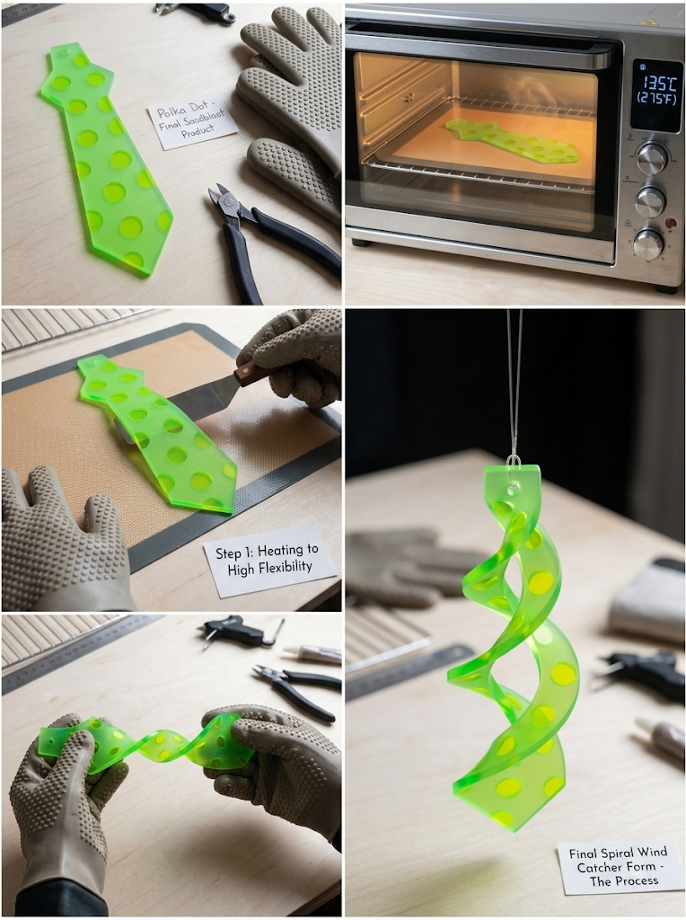
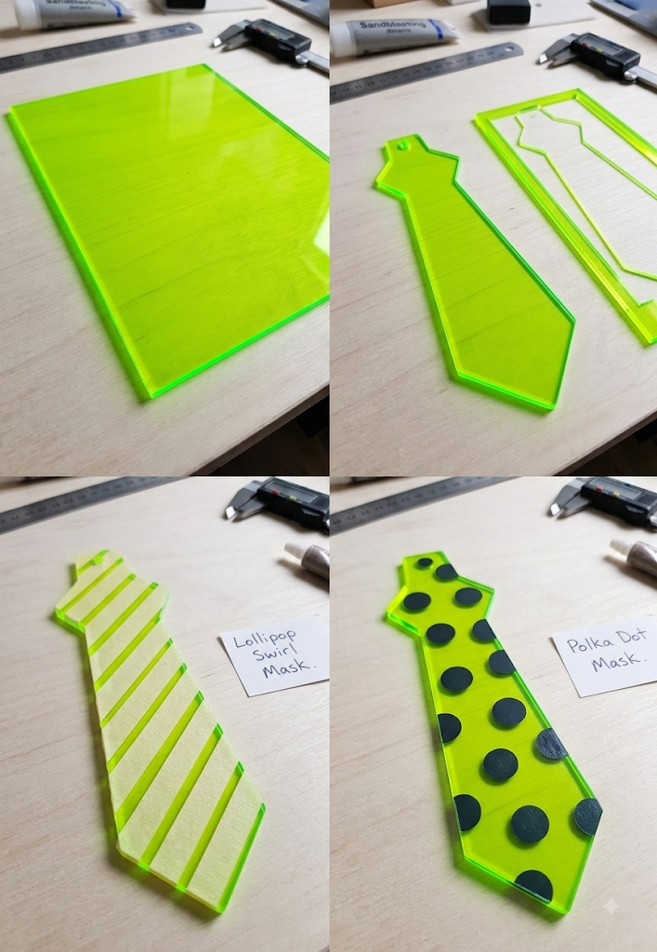
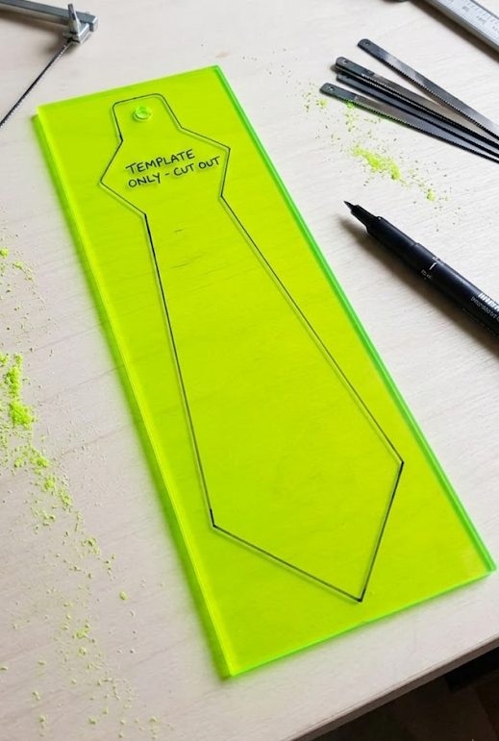
IGCSE Design Technology
Wind Catchers
Prepare for manufacture / Design to Product Process
DESIGN
Critical Thinking Task:
In which order should you manufacture the wind spinner? Which steps are interchangeable? Write a step by step task list on the back of your design sheet
Polish
Marking
Masking
Thermo-forming
Sand-blasting
Cutting & Shaping
Drilling Hole

